Slide 1
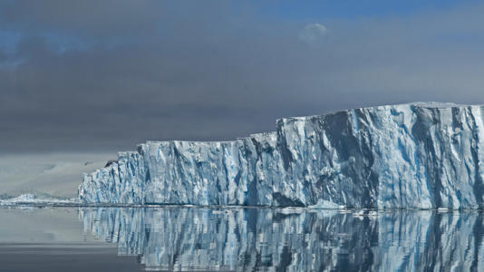
BIOL 1414 Intro to Mol/Cell Biology
Lecture #10
14/15 October 2026
Last Lecture:
Cellular Respiration
Connecting Metabolic Pathways
Regulating Cellular Respiration
Today:
How am I doing?
Photosynthesis (CH. 8)
  Introduction
  Overview
  Basic Photosynthetic Structures
  Light-Dependent Reaction
  Light-Independent Reaction (Calvin Cycle)
Energy Cycle
Thwaites Glacier
AKA – Doomsday Glacier
Notes:
The glacier, located in West Antarctica, has become a focal point of global concern due to its potential to significantly impact coastal communities around the world.
Since 2018, the International Thwaites Glacier Collaboration (ITGC), a joint research initiative between the U.K. and the U.S., has been closely monitoring this immense glacier, which is roughly the size of Florida. Its latest findings reveal alarming trends in ice loss and indicate a heightened risk of collapse.
"Thwaites has been retreating for more than 80 years, accelerating considerably over the past 30 years, and our findings indicate it is set to retreat further and faster“
If Thwaites collapses, the consequences would be catastrophic. Stretching more than 70 miles wide and over 6,500 feet thick, its collapse could expose millions of people in vulnerable low-lying areas—like Bangladesh and the Pacific Islands—to rising sea levels. Major cities, including New York and London, also face increased risk.
Currently, sea levels are rising by 0.13 inches per year, according to NASA. The flow of ice from Thwaites and neighboring glaciers into the ocean has more than doubled since 1990, and this region now contributes to 8 percent of global sea-level rise.
Reducing emissions as fast as possible is still important, Riverman said, as it will slow down the process, giving coastal communities more time to mitigate the effects of rising seas.
By the 23rd century, Thwaites and much of the West Antarctic Ice Sheet could be completely lost, the ITGC said. Thwaites alone holds enough ice to raise global sea levels by more than two feet. If the entire ice sheet it protects also collapses, sea levels could rise by over 10 feet—an outcome that would drastically reshape global coastlines.

Slide 2

How Am I Doing?
On a sheet of paper anonymously tell me:
  What do you like about lecture?
  What could be improved for lecture?
  What do you like about lab?
  What could be improved for lab?

Slide 3
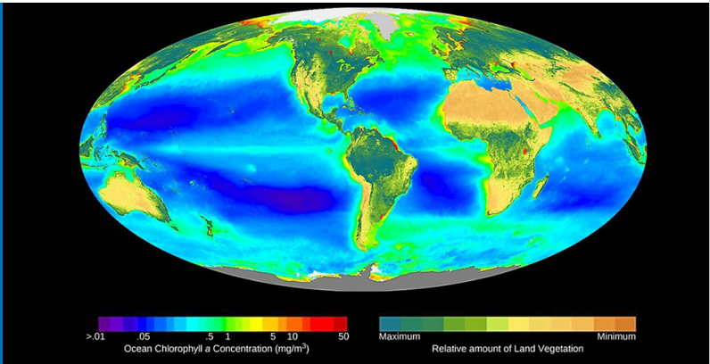
Introduction
Metabolic pathways in all organisms require energy
  Most get this energy from consuming other organisms
    Where does energy stored in food originate?
Notes:
This world map shows Earth’s distribution of photosynthetic activity determined by chlorophyll a concentrations. On land, chlorophyll is evident from terrestrial plants, and within oceanic zones, from chlorophyll from phytoplankton. (credit: modification of work by SeaWiFS Project, NASA/Goddard Space Flight Center and ORBIMAGE)

Slide 4
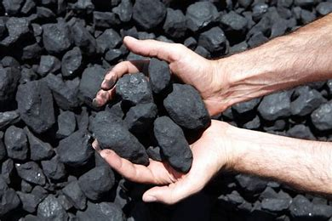
Photosynthesis - Overview
Photosynthesis
  Vital to nearly all life on Earth
    Animals and plants depend on it
  Only biological process that can capture sunlight and convert it into chemical compounds
    Sunlight energy is captured – energizes electrons – energy stored in chemical bonds of sugar molecules
      Energy used by organisms to power metabolism
  Source of oxygen for many living organisms
  How long does energy last?
    Very short times – used quickly
      Consumed food and used in matter of hours
    Very long times – 200-350 million years ago
      Energy produced form burning fossil fuels

Slide 5
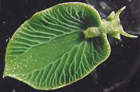
Photosynthesis - Overview
Autotroph – capable of making their own food
  Photoautotroph – use light to manufacture own food
    Plants, algae, cyanobacteria
      Only organisms know to have this capability
        Always exceptions to the rule
  Chemoautotrophs – obtain energy by extracting it from inorganic chemical compounds
    Small group of bacteria
Heterotrophs – “other feeders” – rely on sugars produced by other organisms for energy
  Animals, fungi, most bacteria
Mixotrophs – use both auto- and heterotrophy
  Solar Powered Sea Slug

Slide 6
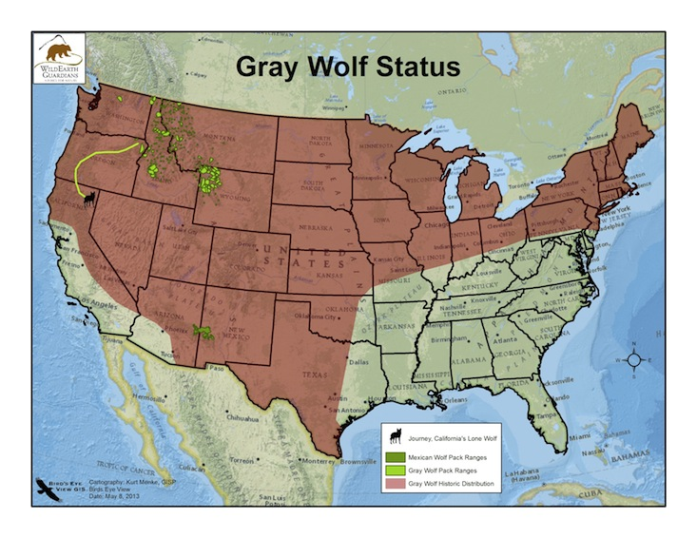
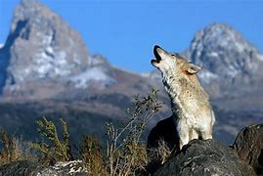
Photosynthesis - Overview
Importance goes beyond capturing sunlight energy
  A lizard sunning itself on a cold day
    Captures sunlight energy to warm its body
It evolved to store the energy from solar radiation
  Photo = sun
  Synthesis = energy stored in C-C bonds of carbohydrates
    These carbohydrates are used to form ATP in cellular respiration
      Powers 99% of Earth’s ecosystems
Notes:
When a top predator, such as a wolf, preys on a deer (Figure 8.3), the wolf is at the end of an energy path that went from nuclear reactions on the surface of the sun, to visible light, to photosynthesis, to vegetation, to deer, and finally to the wolf

Slide 7
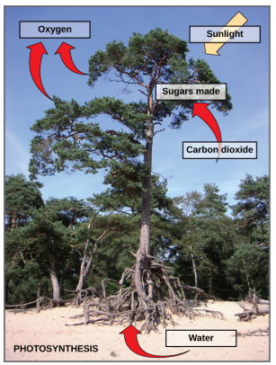
Photosynthesis - Overview
Summary
  Multi-step process
  Requires reactants:
    Specific wavelengths of light
    Carbon Dioxide
      Low in energy
    Water
  Products produced:
    Oxygen
    G3P – glyceraldehyde-3-phosphate
    Simple carbohydrate molecules
      Can be converted into:
        Glucose
        Sucrose
        Dozens of other sugar molecules

Slide 8
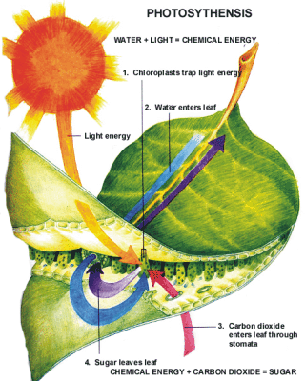
Photosynthesis
CO₂ + H₂O → C₆H₁₂O₆ + O₂
Carbon Dioxide + Water → Glucose + Oxygen
Backbone of all Organic Molecules

Slide 9
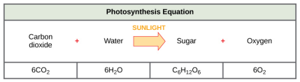
Photosynthesis - Overview
Summary
  Multi-step process
Notes:
Although the equation looks simple, the many steps that take place during photosynthesis are actually quite complex. Before learning the details of how photoautotrophs turn sunlight into food, it is important to become familiar with the structures involved.

Slide 10
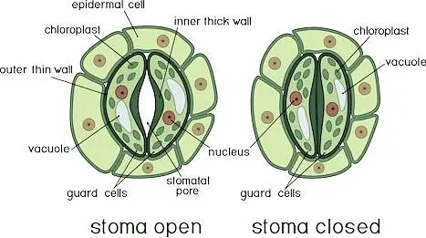
Basic Photosynthetic Structures
Photosynthesis generally takes place in the leaves
  Leaves composed of many layers
    Photosynthesis occurs in the mesophyll
      Mesophyll – middle most layer of a leaf
  Gas exchange (O₂ & CO₂) happens through stomata
    Stomata (Stoma) – small regulated pore regulating gas exchange and water balance
      Usually located on the lower surface of the leaf
        Reduces exposer to sun and wind – minimizing water loss
      Stoma surrounded by guard cells
        Guard cells swell or shrink based on osmotic pressure
        Regulates closing and opening of stoma
        Influences rate of gas exchange and water loss

Slide 11
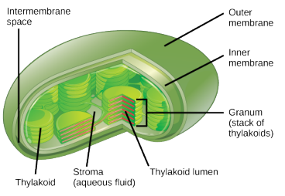
Basic Photosynthetic Structures
In all autotrophic eukaryotes photosynthesis occurs in the Chloroplasts
  Chloroplasts have a double membrane
    Derived from ancient free-living cyanobacteria
  Inside chloroplasts are thylakoids
    Thylakoids – disc shaped structure that contains chlorophyll
      Chlorophyll – pigment responsible for initial interaction of light and plant
        Pigment is a molecule that absorbs light
      Also contains many proteins making up the electron transport chain
    Thylakoid lumen – internal space of a thylakoid
      Created or defined by the thylakoid membrane
    Granum – stack of thylakoids
    Stroma – liquid surrounding the granum
Notes:
Stroma vs. stomata be aware

Slide 12
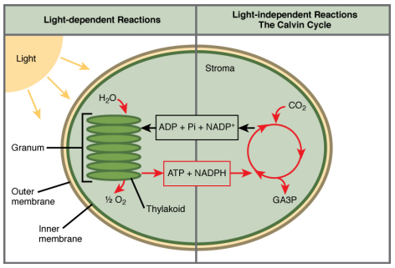
Two Parts of Photosynthesis
Photosynthesis occurs in two stages:
  Light-dependent reaction – energy is absorbed by chlorophyll and is then converted into stored chemical energy
  Light-independent reaction – stored energy from above reaction drives assembly of sugar molecules from CO₂
    Does not directly require light but…
      Needs products from light-dependent reaction to function
      Many enzymes used here are activated by light

Slide 13
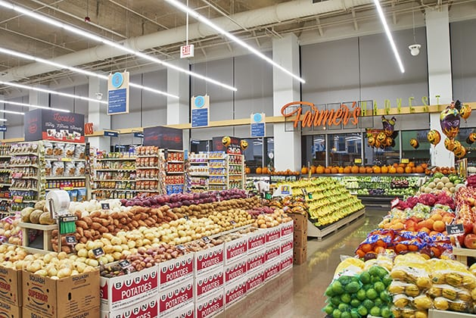
Everyday Connection
Notes:
Major grocery stores in the United States are organized into departments, such as dairy, meats, produce, bread, cereals, and so forth. Each aisle (Figure 8.8) contains hundreds, if not thousands, of different products for customers to buy and consume. Although there is a large variety, each item ultimately can be linked back to photosynthesis.
Meats and dairy link, because the animals were fed plant-based foods.
The breads, cereals, and pastas come largely from starchy grains, which are the seeds of photosynthesis-dependent plants.
What about desserts and drinks? All of these products contain sugar—sucrose is a plant product, a disaccharide, a carbohydrate molecule, which is built directly from photosynthesis.
Moreover, many items are less obviously derived from plants: For instance, paper goods are generally plant products, and many plastics (abundant as products and packaging) are derived from “algae” (unicellular plant-like organisms, and cyanobacteria).
Virtually every spice and flavoring in the spice aisle was produced by a plant as a leaf, root, bark, flower, fruit, or stem. Ultimately, photosynthesis connects to every meal and every food a person consumes.

Slide 14
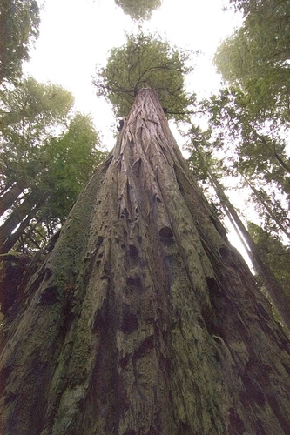
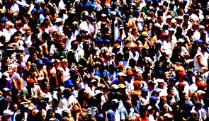
What can Photosynthesis do?
Hyperion
  The world’s tallest tree
  379.1 feet
Human beings
All Biodiversity on Earth
ALL COME FROM CARBON FROM CO₂ IN ATMOSPHERE

Slide 15
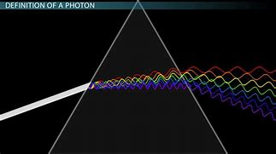
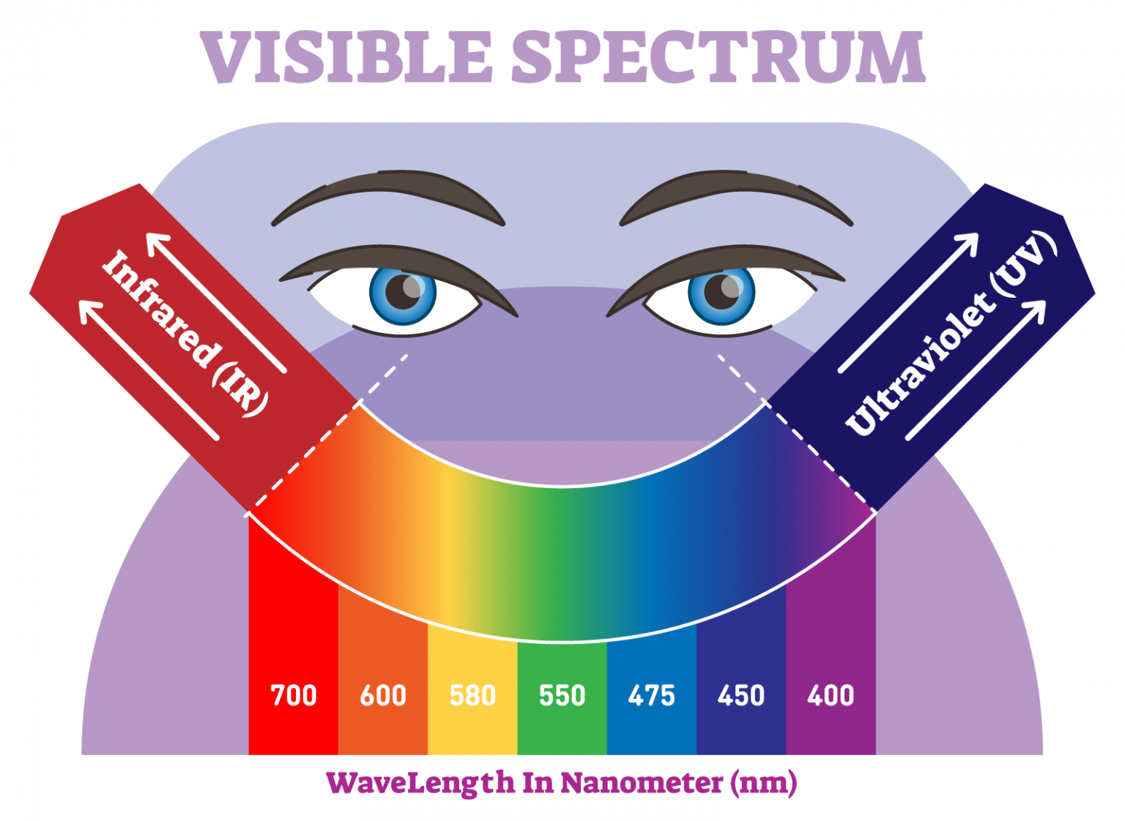
Light-Dependent Reaction
Light energy can:
  Travel
  Change form
  Be harnessed to do work
Photosynthesis
  Light energy converted to chemical energy
  Photoautotrophs use this energy to build carbohydrates
  Only certain wavelengths of light can be used!!

Slide 16
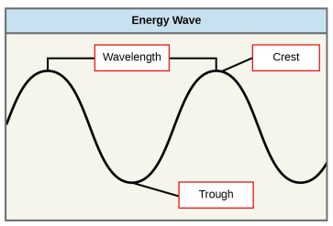
Light-Dependent Reaction
The sun is very important
  Emits large amounts of electromagnetic radiation
    In a spectrum from short gamma rays to long radio waves
  Humans only see a small portion of this energy
    Visible light
  Energy from sun travels in waves
    Energy determined by wavelengths
      Wavelength – distance between consecutive crest points of a wave
        Short wavelengths = more energy = more powerful
        Long wavelengths = less energy = less powerful
Notes:
This may seem illogical, but think of it in terms of a piece of moving heavy rope. It takes little effort by a person to move a rope in long, wide waves. To make a rope move in short, tight waves, a person would need to apply significantly more energy

Slide 17
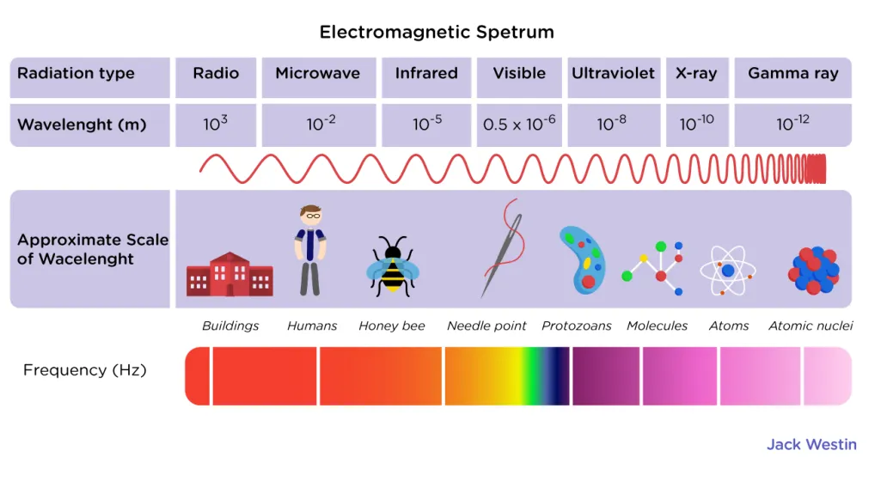
Light-Dependent Reaction
Electromagnetic spectrum – range of all possible frequencies (wavelengths) of radiation
  Differences in wavelengths relates to energy present
  Each type of radiation travels at its own wavelength
Notes:
The higher-energy waves can penetrate tissues and damage cells and DNA, which explains why both X-rays and UV rays can be harmful to living organisms.

Slide 18
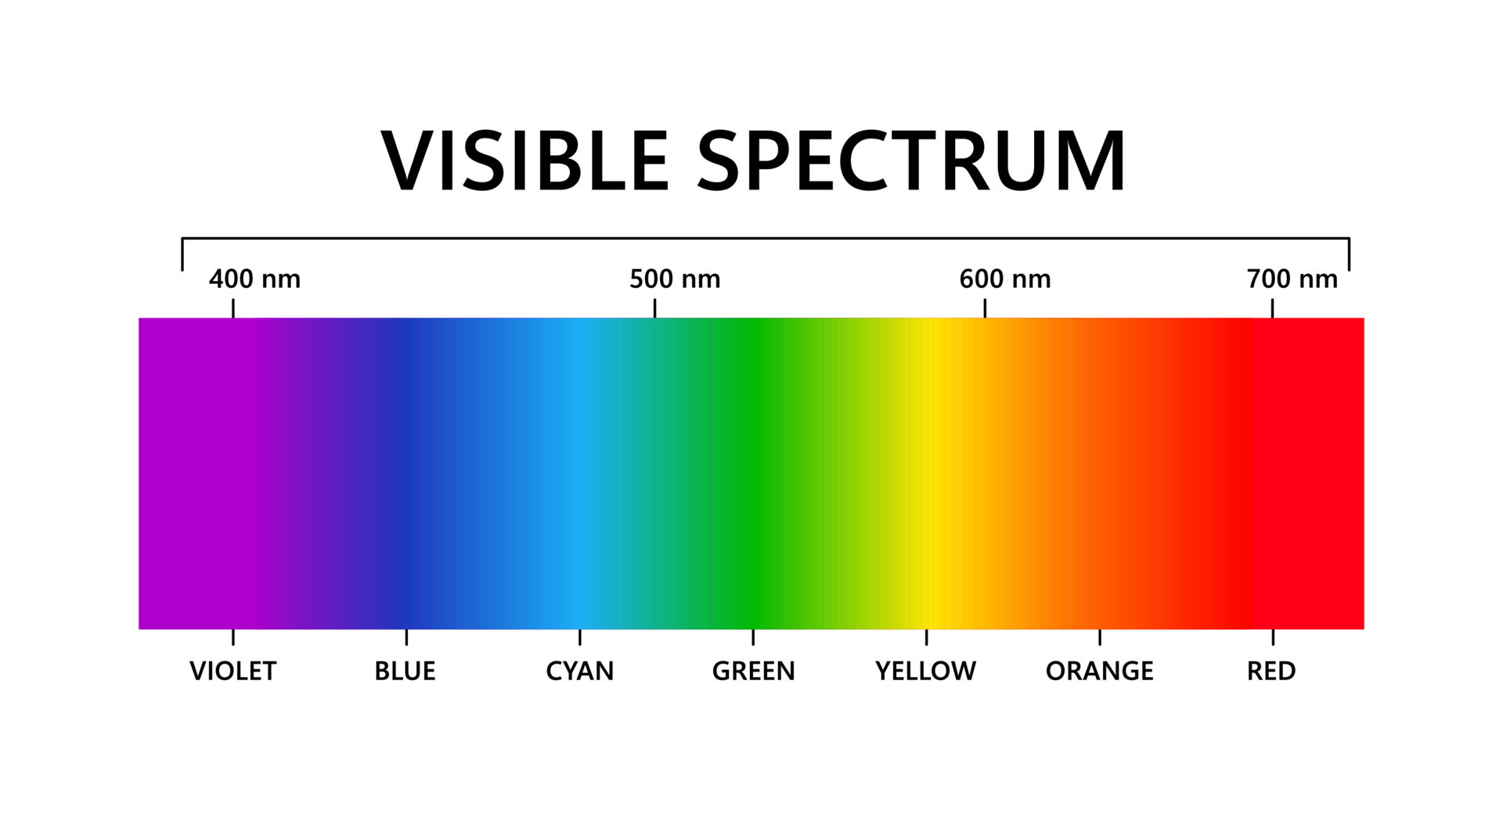
Light-Dependent Reaction
Light energy initiates photosynthesis when a pigments absorb specific wavelengths of light
  All organic pigments absorb only a small spectrum of light
  Energy levels lower than red wavelength
    Too low to excite electron to start process
  Energy levels above blue wavelength
    Too high will tear molecules apart
      This process is known as bleaching
Our eyes can only see 400-700nm
  This is the visible light spectrum
Plants are also only available to absorb 400-700nm
  Photosynthetically active radiation (PAR)

Slide 19
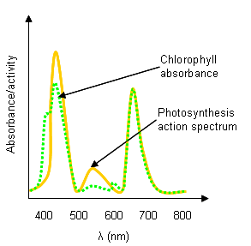
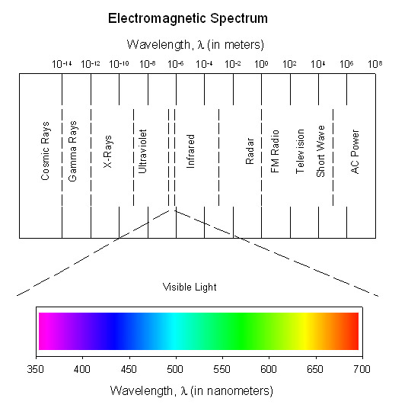
Light-Dependent Reaction
Photosynthetically Active Radiation (PAR) = 400-700nm wavelength of light used in photosynthesis.
Notes:
The visible light seen by humans as white light actually exists in a rainbow of colors.
Certain objects, such as a prism or a drop of water, disperse white light to reveal the colors to the human eye.
The visible light portion of the electromagnetic spectrum shows the rainbow of colors, with violet and blue having shorter wavelengths, and therefore higher energy.
At the other end of the spectrum toward red, the wavelengths are longer and have lower energy.

Slide 20
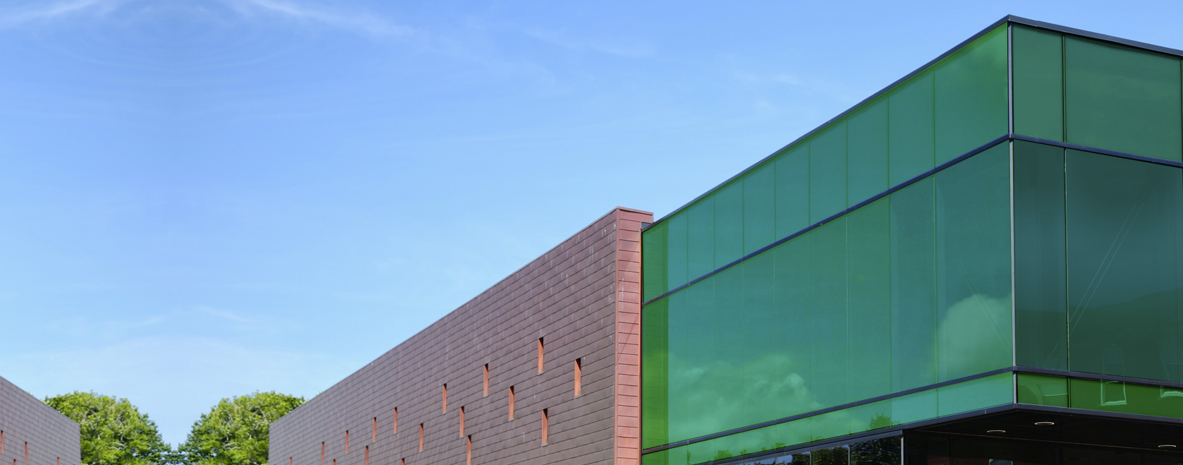
Light-Dependent Reaction
Pigments
  Different pigments exist
    Each absorbs only a specific wavelength of light
    Reflect or transmit colors they cannot absorb
      They appear as a mix of the reflected and transmitted color
Notes:
Is this building good for growing plants in?

Slide 21
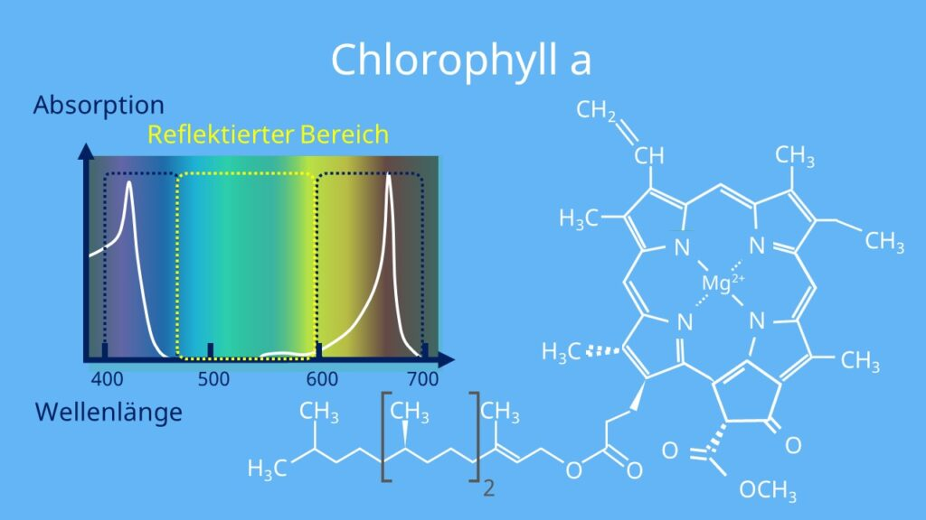
Light-Dependent Reaction
Pigments
  Chlorophylls and Carotenoids
    Two major classes of photosynthetic pigments
      Found in plants and algae
    Each has many types of pigment molecules
  Chlorophylls
    Five major chlorophylls
      A, B, C, D, and bacteriochlorophyll
        Bacteriochlorophyll – chlorophyl related molecule found in bacteria
    We will focus on chlorophyll A and B
      Found in higher plants
Notes:
The carotenoids found in fruit—such as the red of tomato (lycopene), the yellow of corn seeds (zeaxanthin), or the orange of an orange peel (β-carotene)—are used as advertisements to attract seed dispersers.

Slide 22
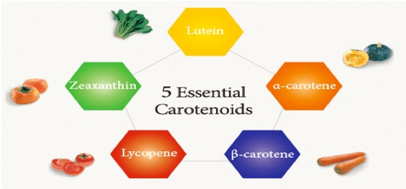
Light-Dependent Reaction
Pigments continued
  Carotenoids
    Dozens of different forms
    Many supply bright colors
    In photosynthesis function to dispose of excess energy
      In full sun light-dependent reactions must handle lots of energy
        If not handled properly this energy can cause lots of damage
      Many reside in thylakoid membrane
        Absorb excess energy and dissipate energy as heat
  Absorption spectrum – specific wavelength of visible light a pigment absorbs
    Can be used to identify pigment
      Chlorophyll a absorbs blue or red and reflects or transmits green
        This is why chloroplast appear green
      Carotenoids absorb in blue region and reflect yellow, red, and orange

Slide 23
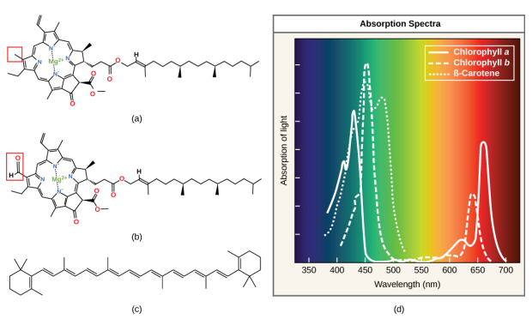

Light-Dependent Reaction
Notes:
Chlorophyll a, (b) chlorophyll b, and (c) β-carotene are hydrophobic organic pigments found in the thylakoid membrane. Chlorophyll a and b, which are identical except for the part indicated in the red box, are responsible for the green color of leaves. β-carotene is responsible for the orange color in carrots. Each pigment has (d) a unique absorbance spectrum.
Notice how each pigment has a distinct set of peaks and troughs, revealing a highly specific pattern of absorption.

Slide 24
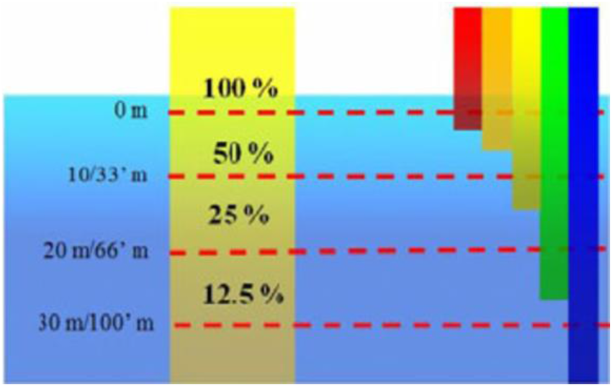
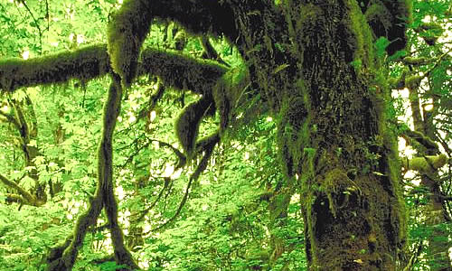
Light-Dependent Reaction
Pigments continued
  Most photosynthetic organisms contain a mix of pigments
    Allows for absorption from a wider range of wavelengths
  Not all organisms are exposed to full spectrum of sunlight
    Some live under water
    Others are in competition for light
      Taller trees in rain forest

Slide 25
Light-Dependent Reaction
How it works
  Main focus – convert light energy into chemical energy
    Forms – ATP and NADPH
    Energy supports light-independent reaction
      Where assembly of sugar molecules occurs
  Photosystem – multiprotein complex that converts light energy into chemical energy
    Two different photosystems found in thylakoid membrane
      Photosystem II (PSII) and Photosystem I (PSI)
        Named as they were discovered not order of transfer
        Differ on what is oxidized and what they reduce
    Each photosystem contains a light harvesting complex
      Antenna proteins – where chlorophyl molecules bind
        Each proteins has 300-400 chlorophyll a and b molecules
      Reaction centers – where photochemistry takes place
      Absorption of each photon of light cause molecule to enter excited state
        Photon – distinct quantity or packet of light energy

Slide 26
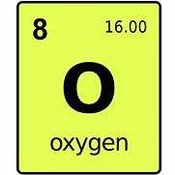
Light-Dependent Reaction
How it works
  Once absorbed by chlorophyll
    Photon has been captured
      Not stored in any useful form
    Transferred form chlorophyll to chlorophyll
      Eventually transferred to reaction center
        Takes about a millionth of a second
      Only energy has been transferred not electrons
    Special chlorophyll a molecules in reaction center
      Undergo oxidation upon excitation
        Photoact – give up an electron during excited state
      Here is when light energy is converted to excited electron (captured)
    Rest of the steps involve getting electron onto NADPH
      Delivery to the Calvin Cycle
    PSII and PSI are part of the photosynthetic electron transport chain
      Water is split to re-reduce PSII after photoact each time
        This is why water is required for photosynthesis
Notes:
Splitting one H2O molecule releases two electrons, two hydrogen atoms, and one atom of oxygen. However, splitting two molecules is required to form one molecule of diatomic O2 gas. About 10 percent of the oxygen is used by 216 Chapter 8 • Photosynthesis Access for free at openstax.org. mitochondria in the leaf to support oxidative phosphorylation. The remainder escapes to the atmosphere where it is used by aerobic organisms to support respiration.

Slide 27
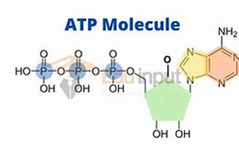
Light-Dependent Reaction
How it works
  As electron moves through PSII to PSI energy is lost
    Used to move hydrogens from stromal side to thylakoid lumen
      Hydrogens from water splitting and above step
        Used to make ATP at a later step
  In PSI electron is reenergized
    PSI oxidized and electron is sent to convert NADP⁺ to NADPH
Summary:
  PSII – captures energy to create proton gradient to make ATP
    Will produce ATP just like in cellular respiration ETC
      Process known as chemiosmosis
  PSI – captures energy to reduce NADP⁺ to NADPH
  Two systems work in concert to make sure:
    ATP production and NADPH are about equal
Notes:
VIDEO

Slide 28
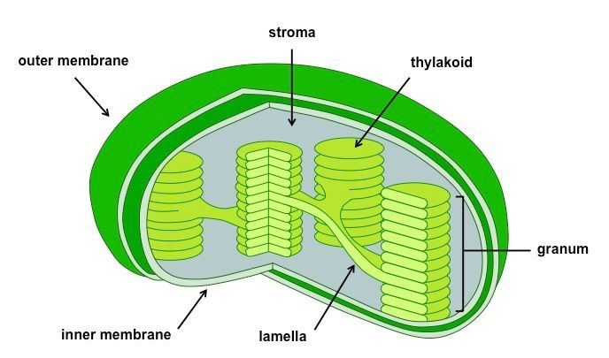
Light-Independent Reaction
After light dependent reaction cell has
  Energy needed to build carbohydrates
    Energy stored in ATP and NADPH
      Last only a few millionths of a second
    Carbohydrates can survive almost indefinitely
      Carbon for backbone comes from CO₂
  CO₂ enters leaves through stomata
    Diffuses short distance into mesophyll
      Then into stroma of chloroplast
        Site of light-independent reactions
  Other names
    Calvin cycle
      Names for scientist who discovered it and it is a cycle
    Calvin-Benson cycle
      Acknowledges another individual involved in its discovery
    Dark cycle – not used as it is misleading

Slide 29
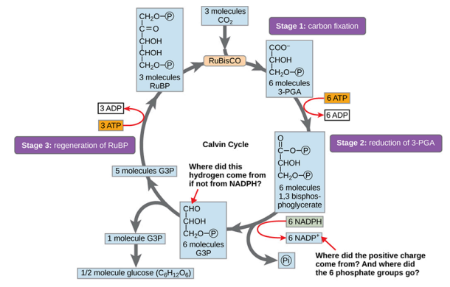
Light-Independent Reaction
Organized into three basic stages:
  Fixation
  Reduction
  Regeneration
Notes:
An enzyme called ribulose-1,5-bisphosphate carboxylase/oxygenase (RuBisCO),
Three molecules of ribulose bisphosphate (RuBP).

Slide 30
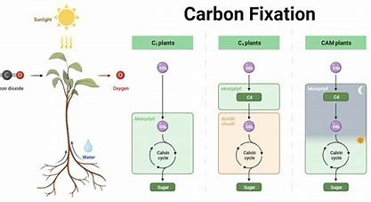
Light-Independent Reaction
Fixation (Stage 1)
  In stroma of cell there is:
    CO₂
    RuBisCO – an enzyme
    RuBP – three molecules
  These three - initiate light-independent reactions
  RuBisCO catalyzes reaction between CO₂ and RuBP
    Forms two molecules of 3-PGA
  This is the carbon fixation step
    Carbon fixation – CO₂ converted from inorganic to organic molecules
Notes:
The primary difference between organic vs. inorganic compounds is that organic compounds always contain carbon while most inorganic compounds do not contain carbon. Also, nearly all organic compounds contain carbon-hydrogen or C-H bonds

Slide 31
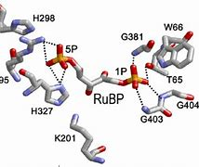
Light-Independent Reaction
Reduction (Stage 2)
  ATP and NADPH convert 3-PGA to G₃P
    Reduction reaction = as 3-PGA gains electrons
      ATP loses energy and is converted to ADP
      NADPH loses energy and a hydrogen atom and is converted to NADP⁺
    Both ADP and NADP⁺ return to light-dependent reaction
      Will be reused and reenergized
Regeneration (Stage 3)
  One G3P leaves Calvin cycle to cell cytoplasm
    Use to form other compounds needed by the plant
  Five remaining G3P molecules stay in cycle
    Used to regenerate RuBP
      Allows more CO₂ to be fixed
  Three molecules of ATP used in regeneration
Notes:
VIDEO

Slide 32
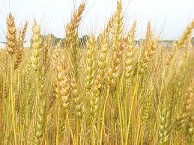
Not All Photosynthesis is Equal
Different plants use different types of photosynthetic pathways
  C3, C4, and CAM:
C3:
  More efficient than C4 and CAM plants under cool and moist conditions and under normal light because requires less machinery (fewer enzymes and no specialized anatomy).
  Stomata open during day
    More evapotranspiration = more water loss
  Most plants are C3
    Oak trees or wheat

Slide 33
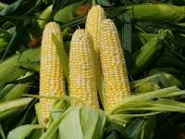
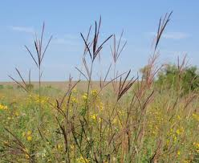
Not All Photosynthesis is Equal
C4:
  Photosynthesizes faster than C3 plants under high light intensity and high temperatures.
  Has better Water Use Efficiency because CO2 brought in faster and so does not need to keep stomata open as much for the same amount of CO2 gain for photosynthesis.
  Stomata open during day but close when CO2 concentrations are high enough
    less water lost by transpiration
  C4 plants include >1,000 species
    Corn the big 4 grasses

Slide 34
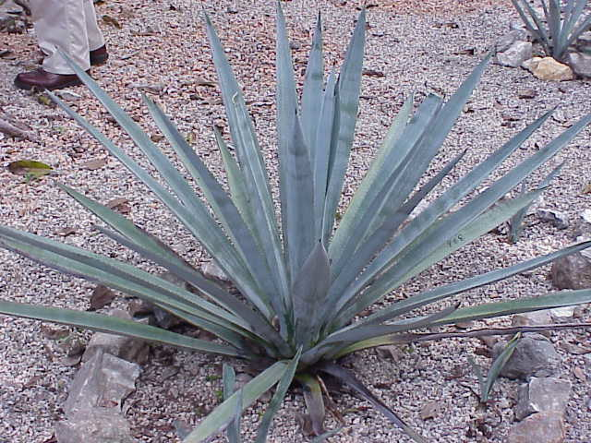
Not All Photosynthesis is Equal
CAM:
  Better Water Use Efficiency than C3 plants under arid conditions due to opening stomata at night when transpiration rates are lower.
  When conditions are extremely arid, CAM plants can just leave their stomata closed night and day.
    Oxygen given off in photosynthesis is used for respiration and CO2 given off in respiration is used for photosynthesis.
  Stomata closed during day open at night
    No sunlight, lower temperatures, lower wind speeds, and lower evapotranspiration
  Most succulent plants
    Cactus and Agaves (Tequila)

Slide 35
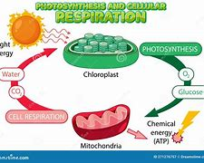
Energy Cycle
Energy Cycle
  Bacterium, plants, or animals
    Obtain energy from breakdown of carbohydrates
  Plants use photosynthesis to make carbohydrates
    Why would they also break them down?
      Plants are living and thus need energy
  In nature there is no such thing as waste
    Every single atom of matter is conserved – recycled over and over
      Substances change form but atoms never disappear
      CO₂ referred to as a waste product of cellular respiration
        CO₂ becomes glucose becomes biomass becomes CO₂
      CO₂ is no more a waster product of cellular respiration than O₂ is of photosynthesis
Notes:
The law of conservation of mass says that matter cannot appear or vanish, only change form or location.
Photo and Resp work in cyclical harmony to allow organism to access life sustaining energy.

Slide 36
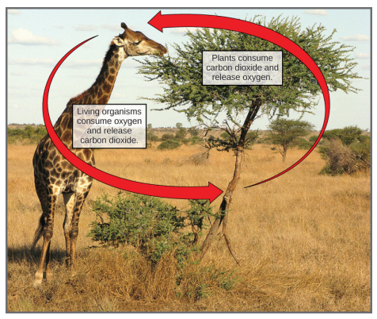
Energy Cycle

Slide 37
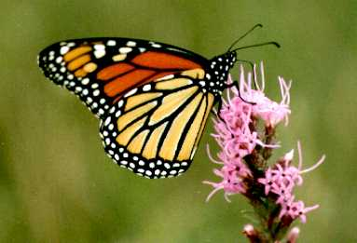
Butterfly and Flower
Which one of these is alive?
Which one has a metabolism?
Which is an autotroph?
Which does photosynthesis?
Which does respiration?

Slide 38
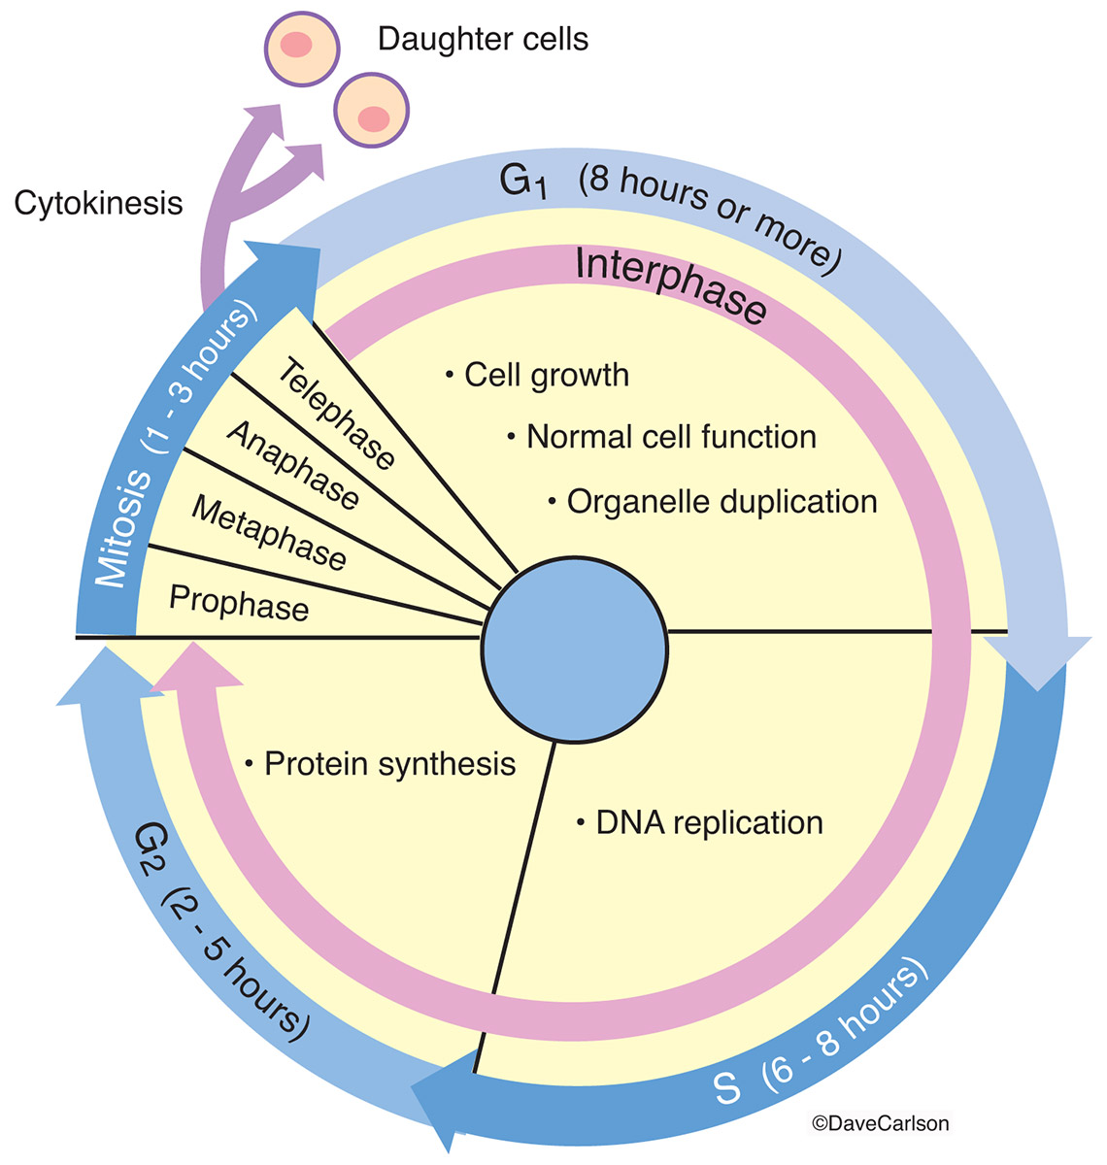
Next Time
Exam #2
Cellular Reproduction
  Mitosis

